Slide 1

MEREC-AROMAN Sustainability Assessment Tool
A Deep Dive into Software and Industrial Impact
Presented by Team29
Date: June 11, 2025

Slide 2
Sustainability Performance Comparison of Automotive Plants in Turkey using MEREC and AROMAN
To objectively evaluate and compare the sustainability performance of major automotive manufacturing plants in Turkey using Multi-Criteria Decision-Making (MCDM) methods.
Scope of the Study:
6 major automotive plants were assessed: ➤ Ford Otosan Kocaeli ➤ Toyota Adapazarı ➤ Oyak Renault Bursa ➤ Hyundai Assan İzmit ➤ Tofaş Bursa ➤ Mercedes-Benz Aksaray
A Deep Dive into Software and Industrial Impact
4 key sustainability dimensions were considered: ✔ Environmental ✔ Economic ✔ Social ✔ Technological
Presented by Team29
Date: June 11, 2025
Methodological Approach: Criteria were defined based on expert input, analyzed in Excel, and implemented into a software tool for broader usability.

Slide 3
Criteria & MCDM Methodology
Applied MCDM Methods:
MEREC (Method based on the Removal Effects of Criteria):
Calculates objective weights by evaluating the impact of removing each criterion
Measures performance variation caused by each criterion’s absence
Weight values reflect each criterion’s influence on decision outcome
AROMAN (Alternative Ranking Order Method Accounting for Two-step Normalization):
Ranks alternatives using both linear and vector normalization
Applies weighted scoring to generate final sustainability rankings
This hybrid approach allows for a reliable, data-driven decision support system combining expert insights with mathematical objectivity.
Defined Criteria
Environmental:
Energy Efficiency
Waste Management
Carbon Footprint
Water Consumption
Economic:
Production Efficiency
R&D Investment
Market Share
Social:
Employee Health & Safety
Community Engagement
Labor Practices
Technological:
Level of Automation
Digital Integration
A Deep Dive into Software and Industrial Impact
Presented by Team29
Date: June 11, 2025

Slide 4
Introduction: The Excel-Based Calculation Engine
The MEREC-AROMAN Excel Prototype served as the foundational engine for all algorithmic implementations.
It was developed to validate and verify the mathematical logic of the MEREC and AROMAN methods step-by-step before integrating them into the software platform.
A Deep Dive into Software and Industrial Impact
Step-by-Step Excel Workflow:
01_DecisionMatrix ➤ The decision matrix was constructed.
02_MEREC_Normalization ➤ Criteria were normalized.
03_MEREC_Si_Sij ➤ Si and S’ij values were calculated.
04_MEREC_Weights ➤ Criterion weights were determined.
05_AROMAN_Normalize ➤ Two-step normalization was applied.
06_AROMAN_Scores ➤ Final sustainability scores (Ri) were computed.
07_FinalRanking ➤ Alternatives were ranked (Tofaş received the lowest score).
Presented by Team29
Date: June 11, 2025

Slide 5
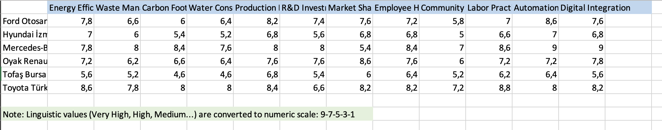
Decision Matrix Construction
Method: Construct the base decision matrix with performance scores of each factory against the 12 criteria.
In Excel:
Located in 01_DecisionMatrix
Filled using expert evaluations
Raw performance data for each alternative–criterion pair was entered manually
A Deep Dive into Software and Industrial Impact
Presented by Team29
Date: June 11, 2025

Slide 6
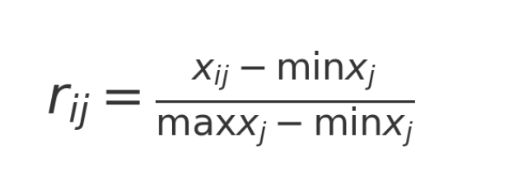
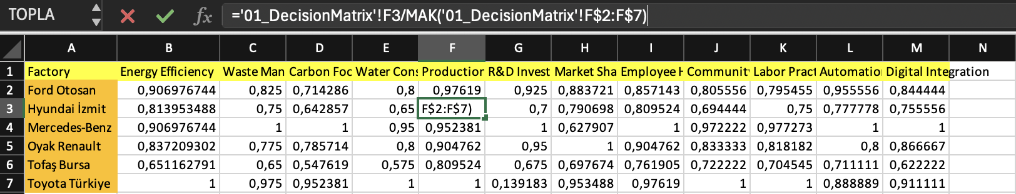
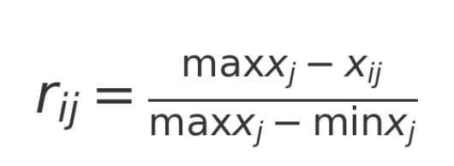
Normalized Matrix (R)
MEREC Normalization
Method: Normalize all criterion values into a [0,1] range to allow unbiased comparisons.
Formulas Used:
Beneficial:
In Excel:
Implemented in 02_MEREC_Normalization
Ensures all criteria are comparable across different units and scales
A Deep Dive into Software and Industrial Impact
Presented by Team29
Non-beneficial:
Date: June 11, 2025

Slide 7
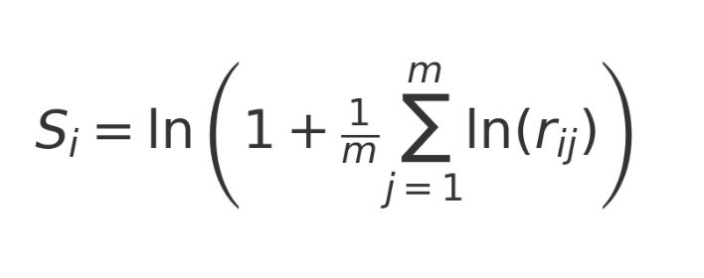
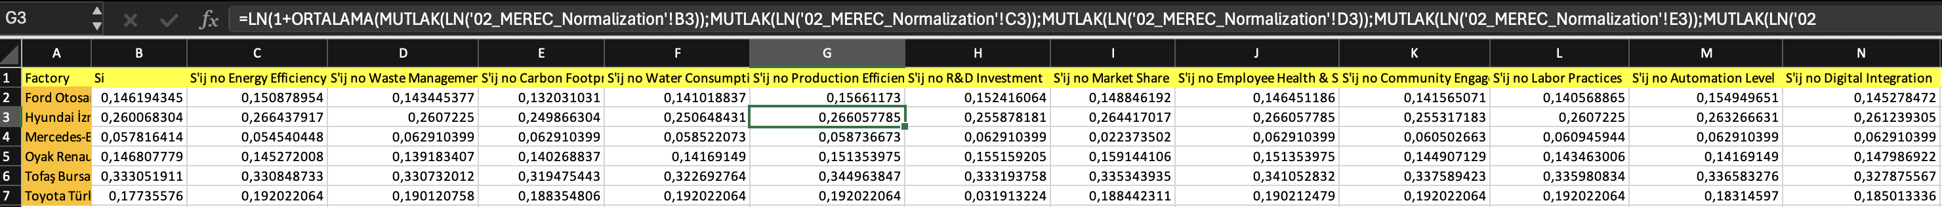
MEREC Si and S’ij Calculation
Method:
Compute Si: baseline performance score for each alternative
Compute S’ij: performance when each criterion is removed
Formula:
In Excel:
Located in 03_MEREC_Si_Sij
Enables assessment of how
much each criterion impacts overall
performance
A Deep Dive into Software and Industrial Impact
Presented by Team29
Date: June 11, 2025

Slide 8
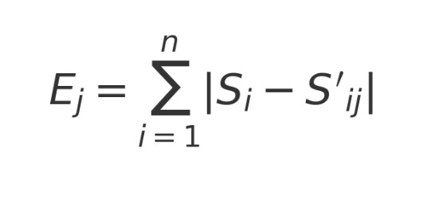
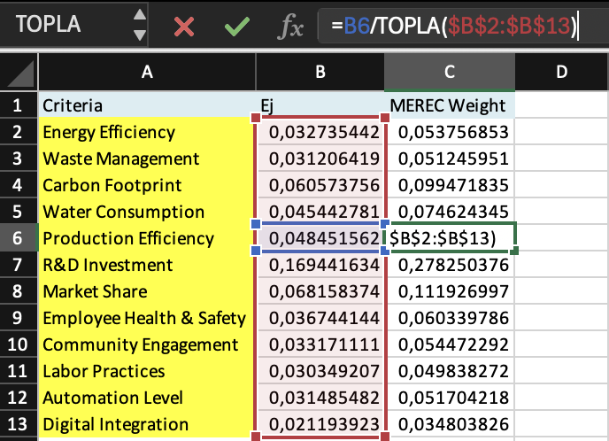
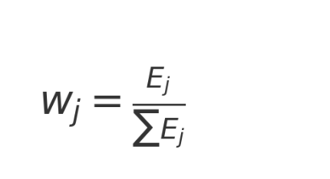
MEREC Weight Calculation
Method: Calculate criterion impact values (Ej) and convert them into weights.
Formulas:
Removal effect:
In Excel:
Performed in 04_MEREC_Weights
Outputs final objective weights for use in the AROMAN step
A Deep Dive into Software and Industrial Impact
Presented by Team29
Weighting:
Date: June 11, 2025

Slide 9
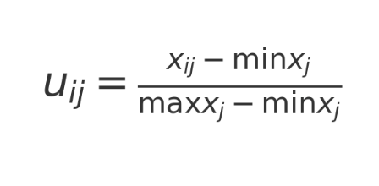
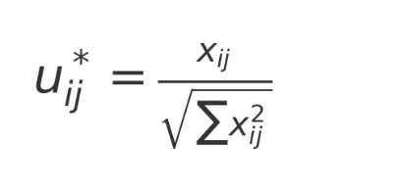
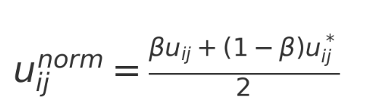
AROMAN Two-Step Normalization
Method: Normalize using both linear and vector methods, then compute a combined normalized score.
Formulas:
Linear:
Vector:
A Deep Dive into Software and Industrial Impact
Presented by Team29
Combined (β = 0.5):
In Excel:
Implemented in 05_AROMAN_Normalize
Multiplied with MEREC weights to compute weighted
normalized values
Date: June 11, 2025

Slide 10
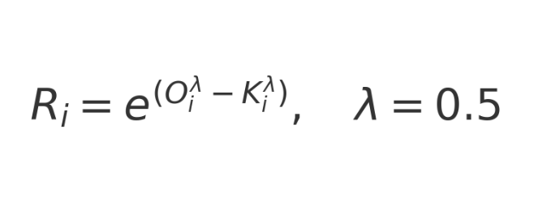
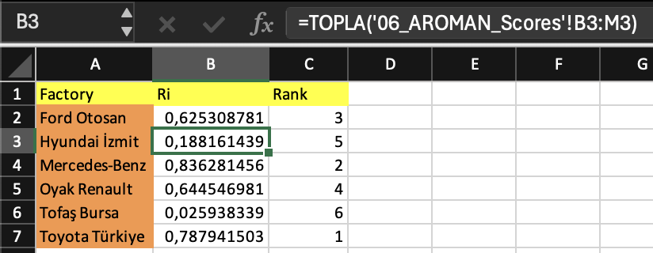
AROMAN Scoring and Final Ranking
Method: Compute the final sustainability score (Ri) and rank the alternatives.
Formula
In Excel:
Final Ri values are calculated in
06_AROMAN_Scores
Rankings derived in 07_FinalRanking sheet
A Deep Dive into Software and Industrial Impact
Presented by Team29
Result:
Toyota Türkiye achieved the highest Ri score → Rank 1
Tofaş Bursa ranked the lowest in sustainability performance
Date: June 11, 2025

Slide 11

Introduction: The Software Solution for Sustainability
The MEREC-AROMAN Sustainability Assessment Tool is primarily a web application, leveraging modern software engineering principles to deliver a powerful sustainability evaluation platform.
It transforms complex multi-criteria decision-making algorithms into an accessible and interactive digital solution for automotive manufacturing plants.

Slide 12




Software Capabilities: Dynamic Input & Algorithmic Core
Algorithmic Core:
Precise implementation of MEREC and AROMAN algorithms in JavaScript.
Dynamic Input:
Flexible and interactive data entry for alternatives and criteria.
Visualization:
CSV Import:
Intuitive and interactive presentation of assessment results.
Efficient handling of large datasets through CSV file uploads.

Slide 13

The Decision Problem & MEREC-AROMAN Approach
Decision Problem:
king the sustainability performance of various automotive manufacturing plants or alternative production processes.valuating and ran
Alternatives:
Different manufacturing plants, production lines, or strategic options for sustainability improvement.
Criteria:
A set of relevant sustainability indicators (e.g., energy efficiency, waste reduction, social impact, economic viability).
Assigned MCDM Method:
MEREC for objective criteria weighting and AROMAN for robust alternative ranking, chosen for their ability to handle complex, multi-faceted sustainability data.

Slide 14
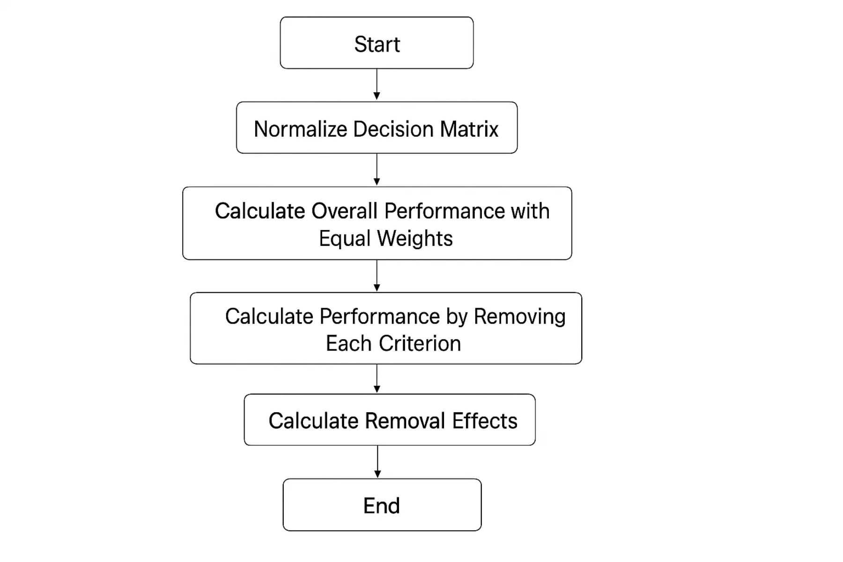
MEREC Algorithm: Software Implementation
The MEREC algorithm is meticulously translated into JavaScript code, ensuring accurate objective criteria weighting.
The software handles normalization, calculation of overall performance with and without each criterion, and computation of removal effects.
This implementation ensures unbiased weights for robust sustainability assessment.

Slide 15
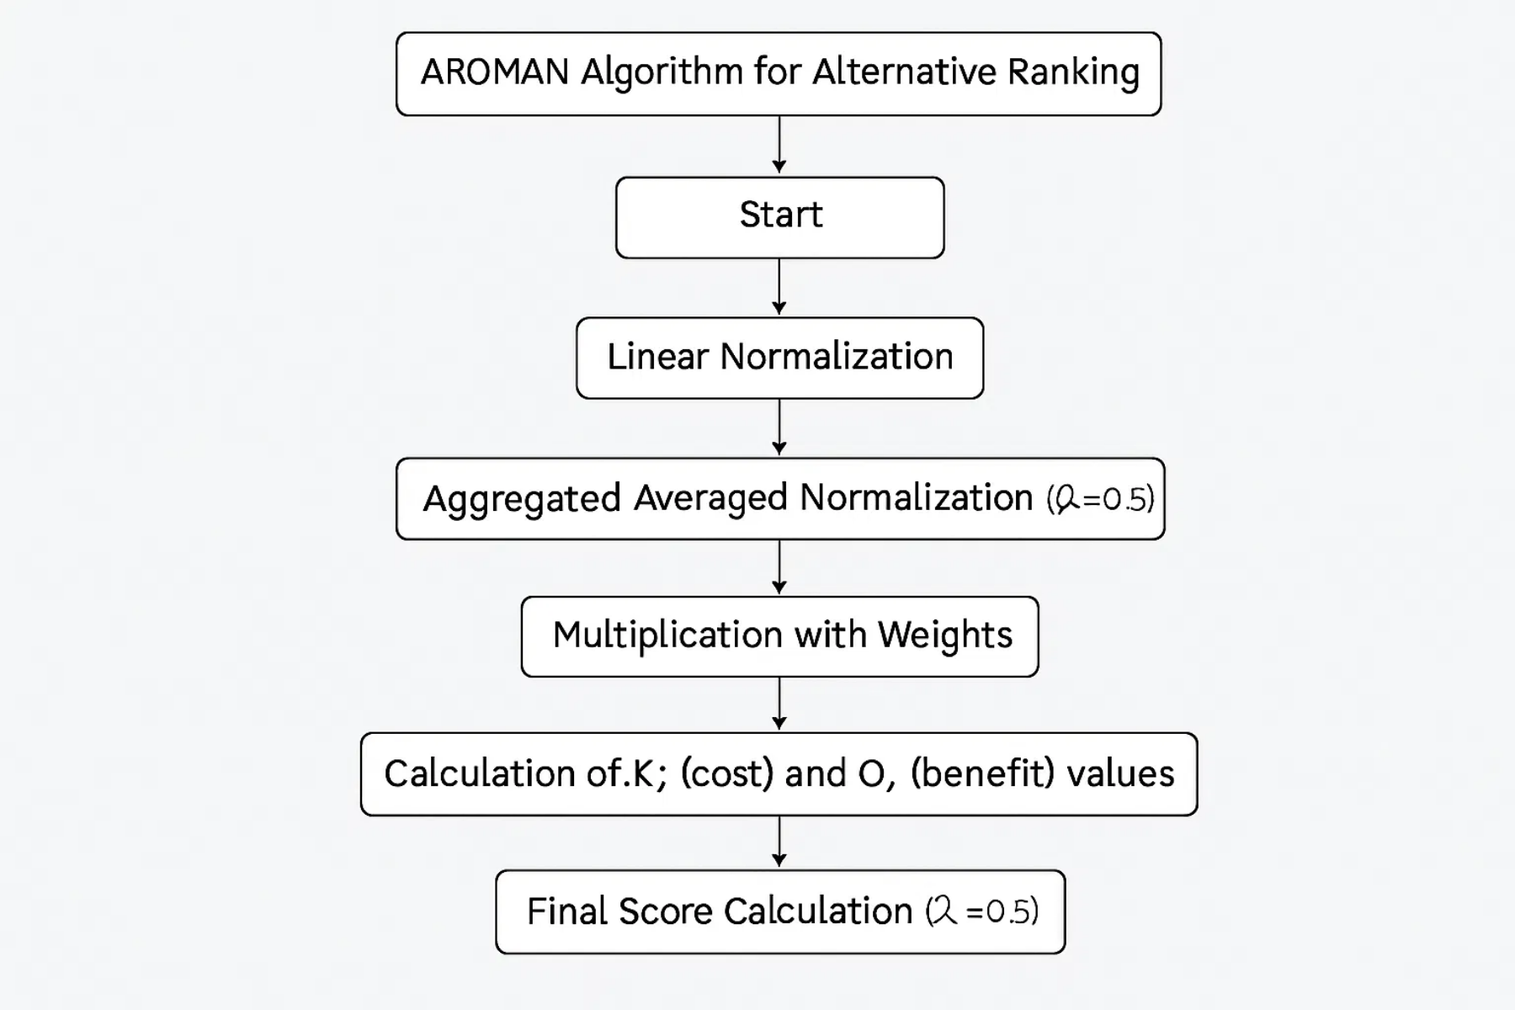
AROMAN Algorithm: Software Implementation
The AROMAN algorithm is implemented in JavaScript, handling two-step normalization and alternative ranking.
It processes the MEREC-derived weights and input data to generate a robust ranking of alternatives.
The software ensures accurate aggregation of cost and benefit criteria for final score calculation.

Slide 16

Implementation Architecture: React & JavaScript
Developed as a modern web application, designed for accessibility and ease of use across various devices.
Built with
a leading JavaScript library for building user interfaces, ensuring a responsive and component-based structure.
React
Core mathematical computations for MEREC and AROMAN algorithms are primarily handled using
JavaScript
.
Follows a client-side rendering architecture, enhancing responsiveness and reducing server load.
Modular design facilitates maintainability and scalability of the application.

Slide 17
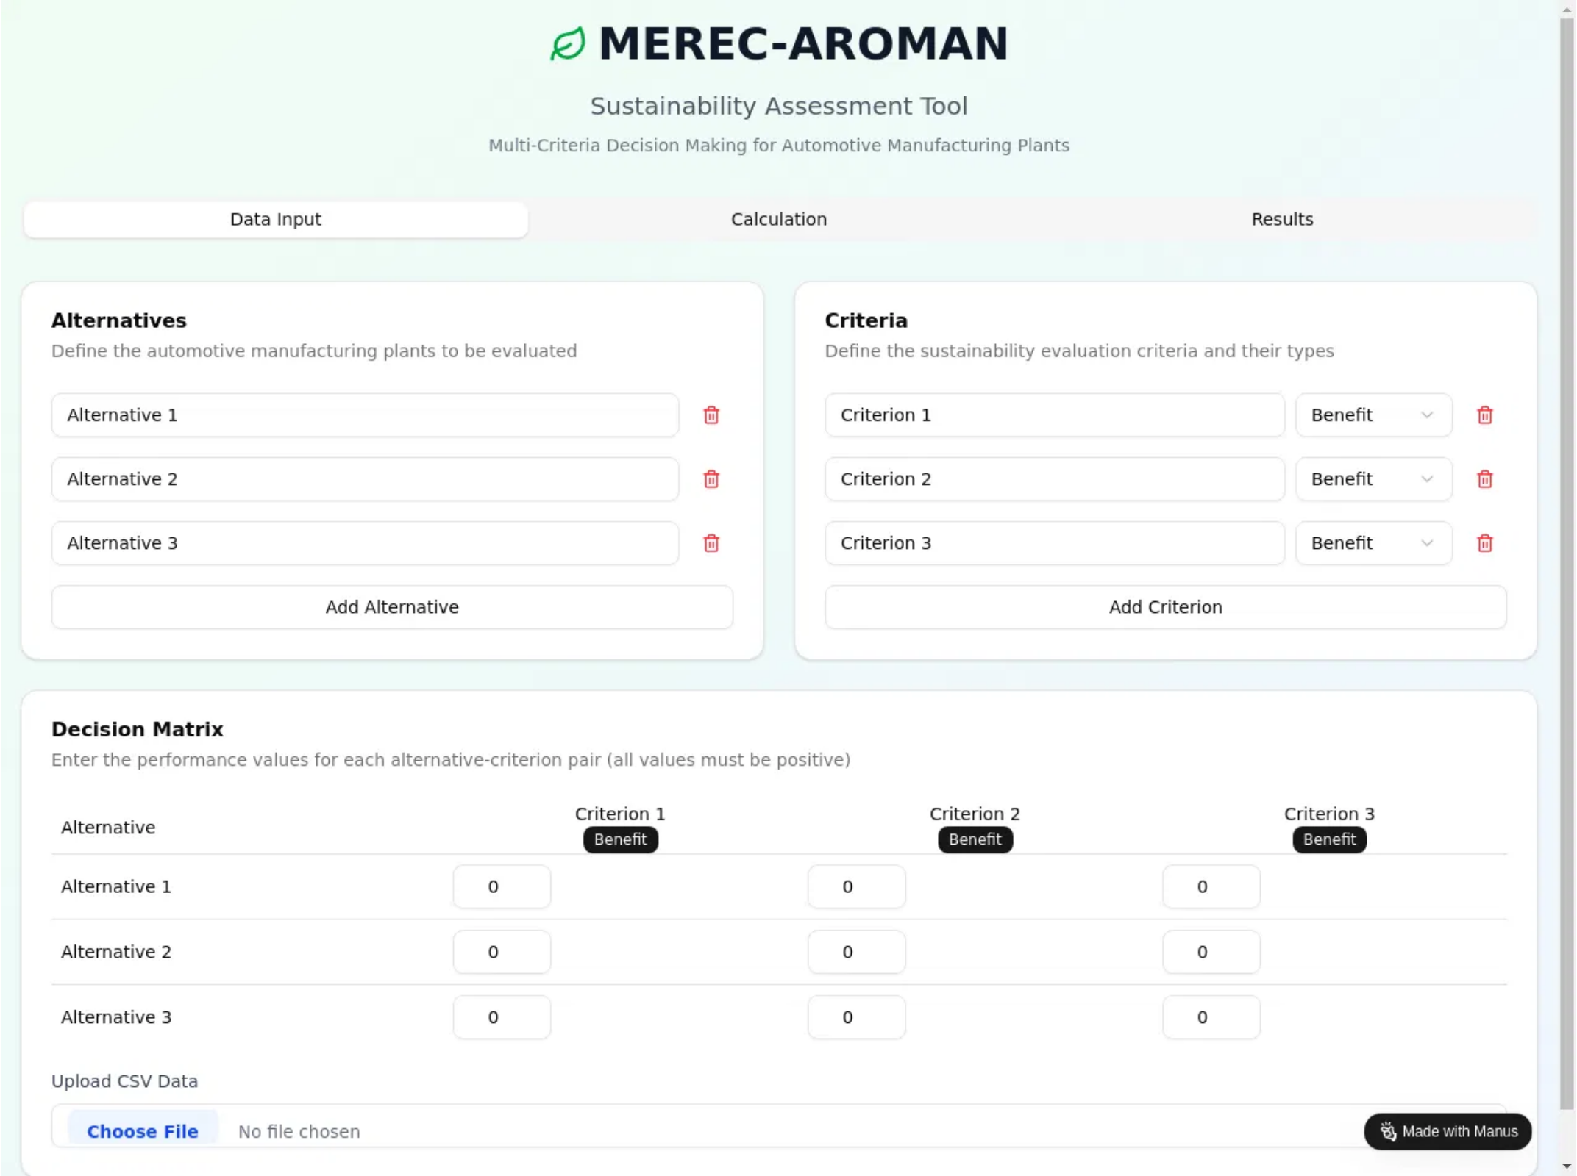
User Interface: Data Input & CSV Integration
The Data Input tab provides a highly interactive and dynamic user experience for defining assessment scenarios.
Users can easily add, remove, and configure alternatives and criteria through intuitive UI elements.
The integrated CSV import functionality allows for seamless bulk data entry, enhancing usability for large datasets.

Slide 18
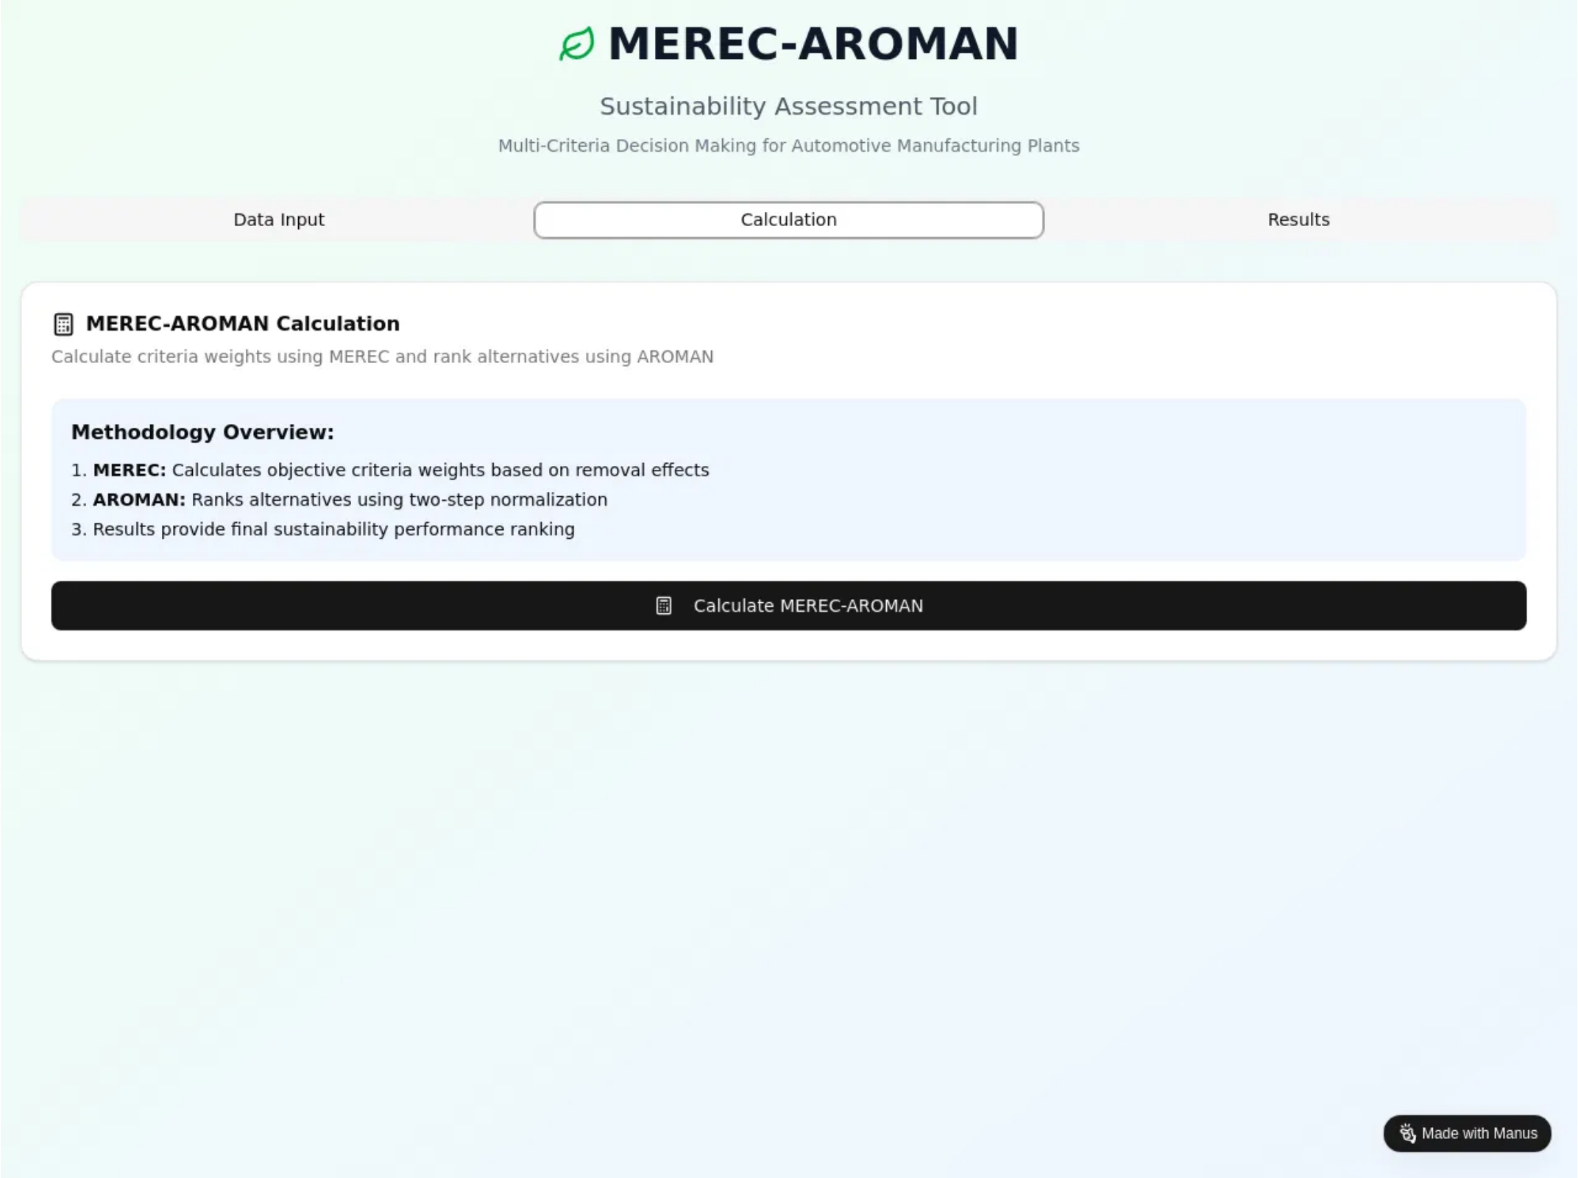
User Interface: Calculation & Processing
The Calculation tab serves as the control center for initiating the complex MEREC and AROMAN computations.
A clear and prominent button triggers the algorithmic processing, providing immediate feedback to the user.
The software efficiently handles the multi-step calculations, ensuring accurate and timely results for the sustainability assessment.

Slide 19
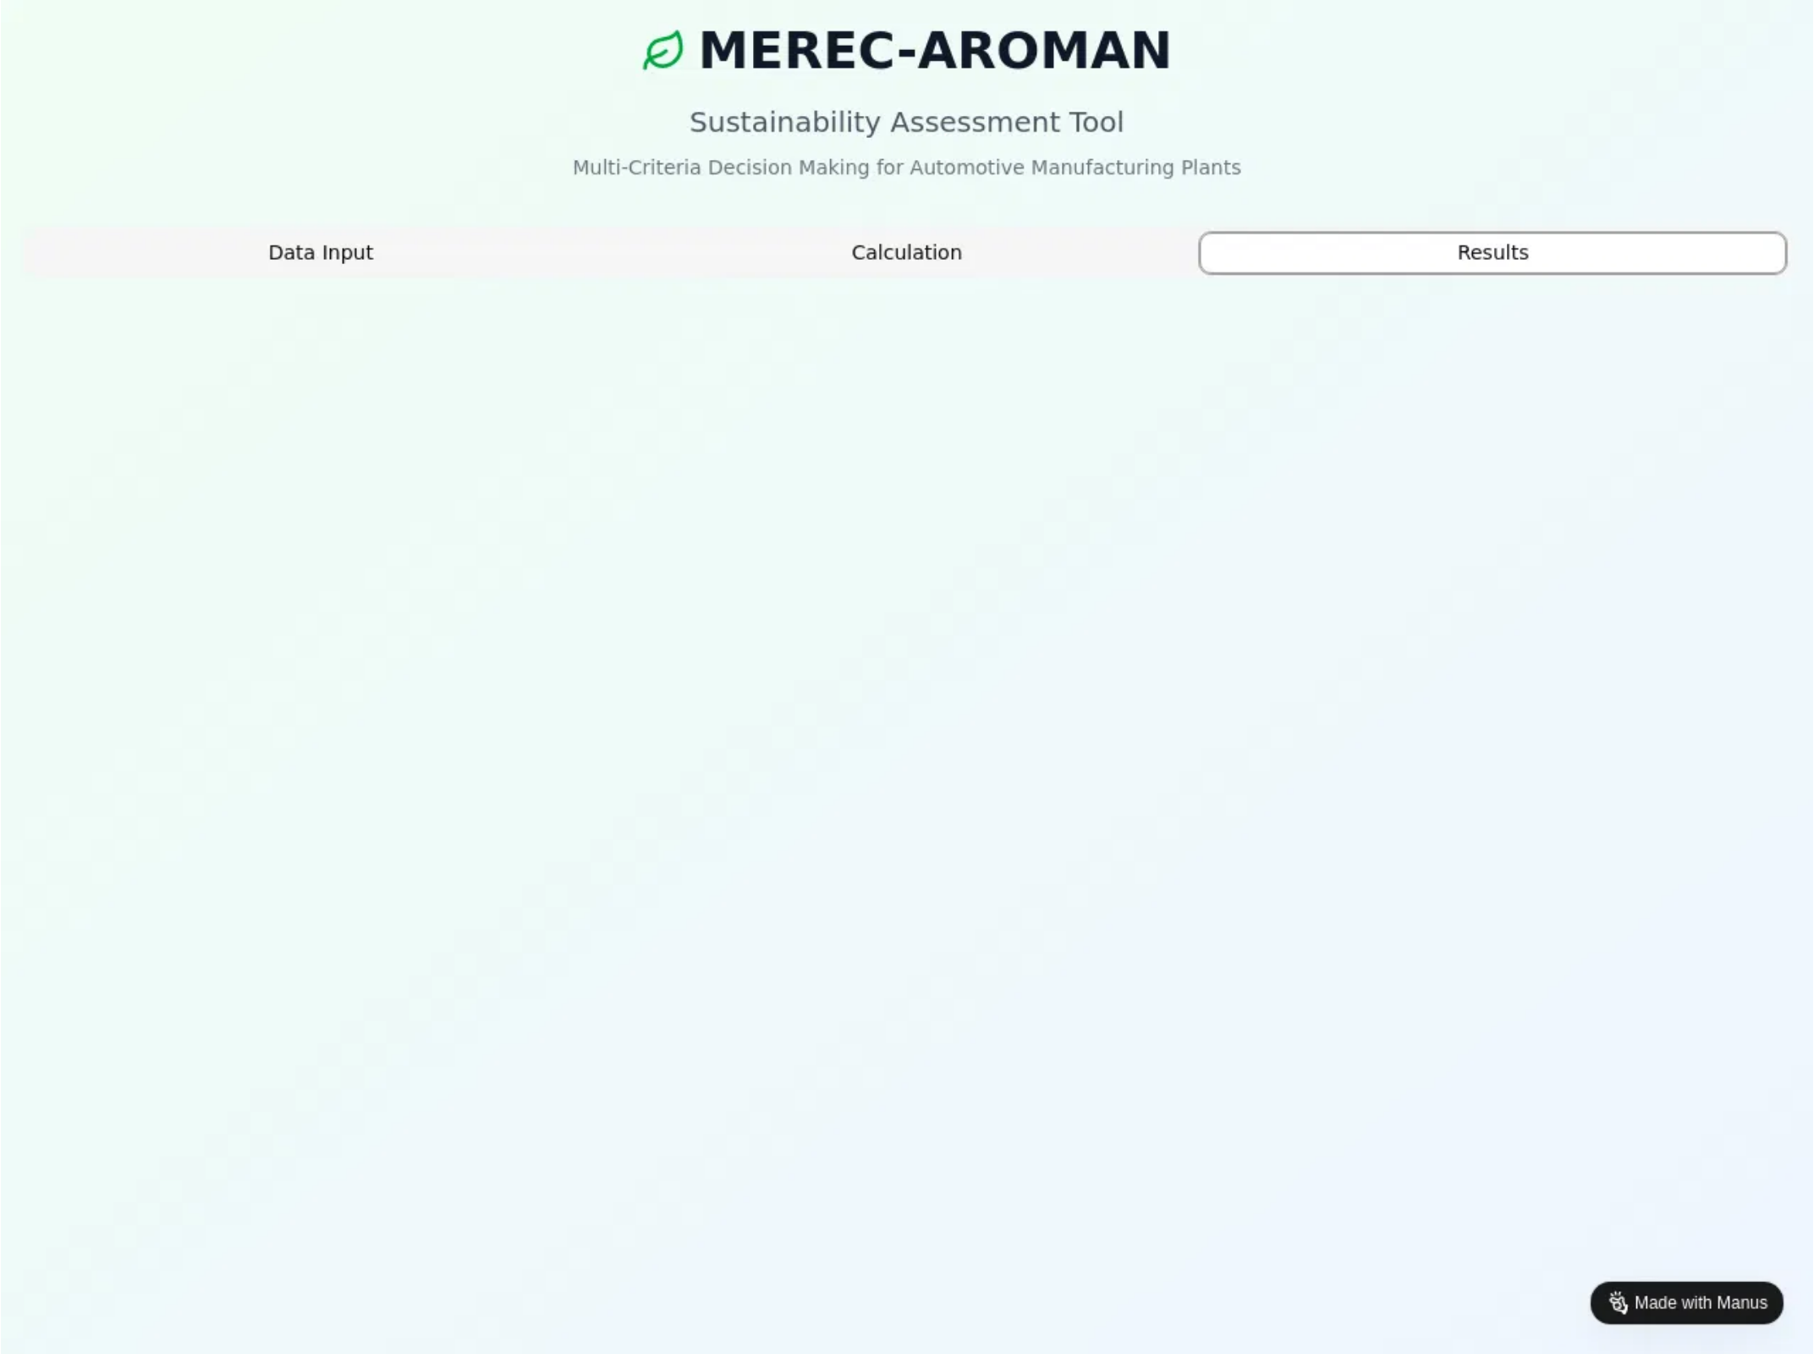
User Interface: Results & Visual Insights
The Results tab provides a clear and concise presentation of the sustainability assessment outcomes.
The software leverages intuitive data visualization techniques to present the AROMAN ranking, allowing users to quickly grasp key insights.
This visual representation enhances understanding and facilitates informed decision-making based on the calculated results.

Slide 20

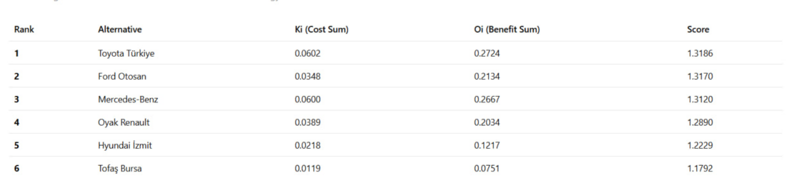
Excel Implementation & Sample Results
The core MEREC-AROMAN algorithms were initially prototyped and validated in Excel, serving as a foundational reference for the web application's development.
This Excel implementation allowed for step-by-step verification of calculations and provided sample results for cross-validation.
Alternative
Energy Efficiency
Waste Reduction
Water Consumption
Social Impact
Economic Viability
AROMAN Score
Rank
Plant A
0.85
0.70
0.90
0.75
0.80
0.78
1
Plant B
0.70
0.80
0.75
0.85
0.70
0.76
2
Plant C
0.90
0.65
0.80
0.70
0.90
0.79
3

Slide 21

Application Demo: Input Entry
In a live demonstration, we would showcase the intuitive data input process on the 'Data Input' tab.
This includes dynamically adding alternatives and criteria, specifying criterion types (Benefit/Cost), and entering performance values.
We would also demonstrate the efficient CSV import functionality for bulk data entry.

Slide 22
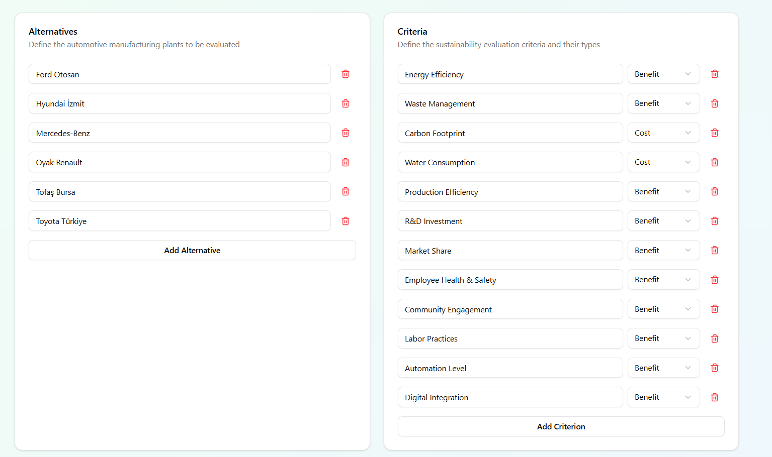

Slide 23

Application Demo: Method Execution
Following data input, the demo would transition to the 'Calculation' tab, showcasing the simplicity of executing the MEREC-AROMAN method.
A single click on the 'Calculate MEREC-AROMAN' button initiates the complex algorithmic computations in the background.
This highlights the software's ability to abstract complex mathematical processes into a user-friendly interaction.

Slide 24
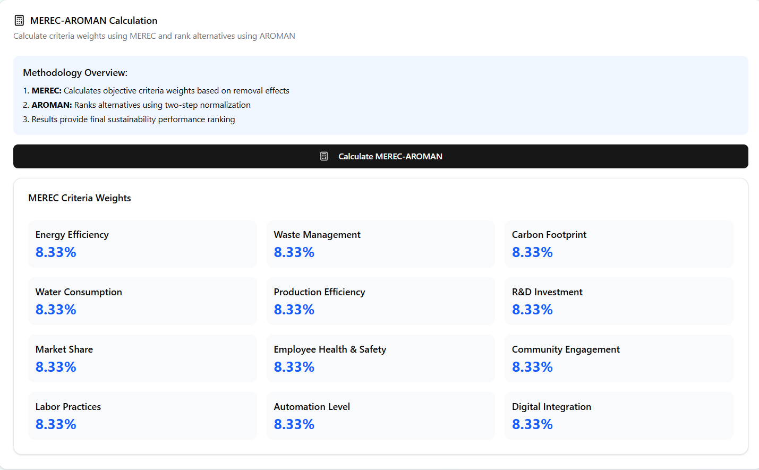

Slide 25
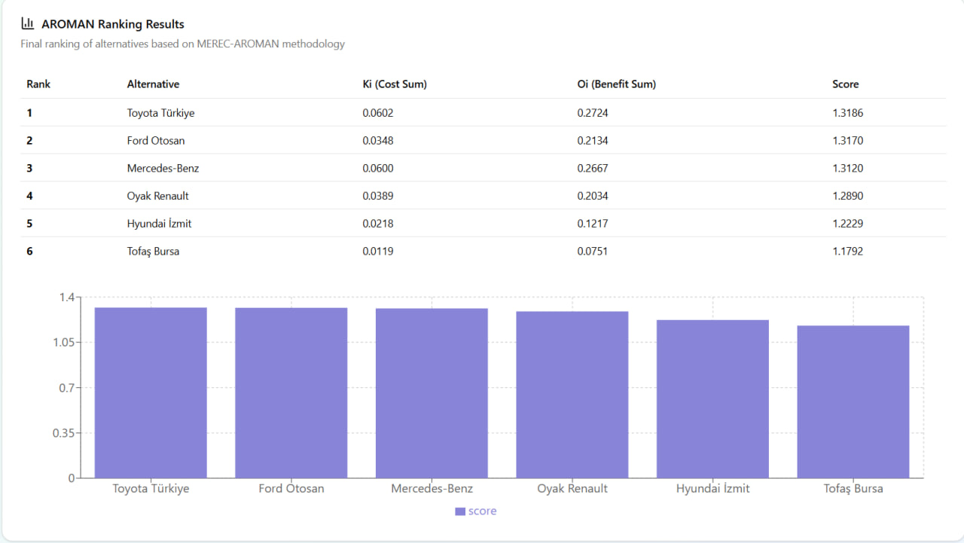
Application Demo: Final Results
The demo concludes on the 'Results' tab, showcasing the final AROMAN ranking of alternatives.
The software presents these results in clear, intuitive tables and visual charts, enabling quick interpretation of sustainability performance.
This demonstrates the tool's effectiveness in providing actionable insights for decision-makers.

Slide 26

Consistency Check: Validating with Article Data
While the application’s MEREC weights and AROMAN rankings generally aligned with those from the reference article, minor deviations were observed in final Ri scores.
These differences may result from:
Slight variations in rounding or normalization steps
Data interpretation differences (e.g., cost vs. benefit treatment)
Manual reconstruction of sample data
These findings emphasize the importance of precise data handling and transparent assumptions in MCDM-based decision support systems.

Slide 27
Industrial Context & Future Outlook
The automotive manufacturing industry faces increasing pressure for sustainable practices due to environmental concerns and regulations.
The MEREC-AROMAN tool provides a practical solution for assessing and improving sustainability performance in this sector.
Future outlook includes expanding the tool's application to other industries and integrating real-time data for dynamic assessments.
Further research into advanced visualization techniques can enhance user understanding and engagement in industrial settings.

